Slide 1
CineMatch
Movie Storage & Recommendation System
Brahmos Ryan Sharma – 21BTRCL023

Slide 2
Introduction
CineMatch is a Python-based movie recommendation system designed to manage and suggest movies to users using efficient in-memory data structures. The system offers three main functionalities: storing movie details, searching for movies, and recommending top-rated movies based on user-defined criteria.
Languages: Python
Data Structures: Movies are stored in lists and dictionaries.
Sorting: Bubble sort for sorting movies based on ratings.
Searching: Linear search for finding movies by title or genre.

Slide 3
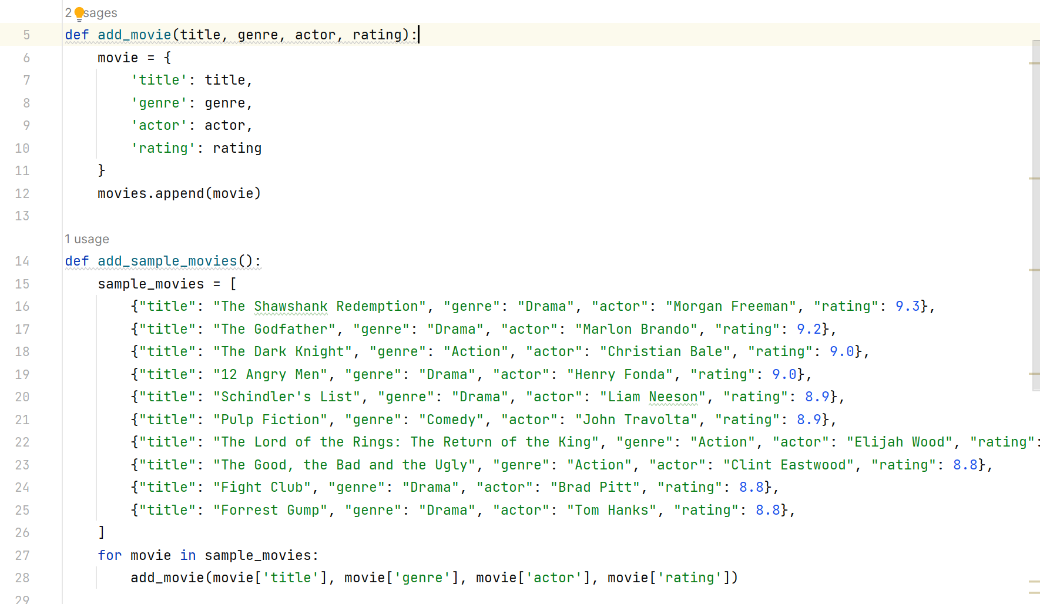
Features & Functionalities
Add Movie:
Users can add movies with details including title, genre, actors, and rating.
Data is stored in dictionaries for efficient access and retrieval.
The ratings are limited between 1 & 10. Three different genres are validated

Slide 4
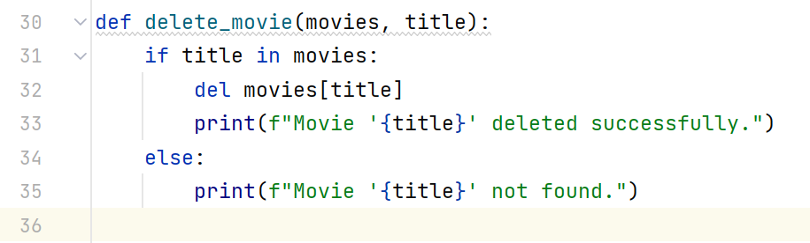
Features & Functionalities
Delete Movies:
Users can delete a movie from the list using the title.
Linear search is used to find the title in the dictionary.

Slide 5

Search & Recommend
A user can search for a movie and then similar movies are recommended based on genre. Similar to Netflix’s recommendation system, when we type the title of a movie/show, we get details of that movie and also get similar movies.

Slide 6
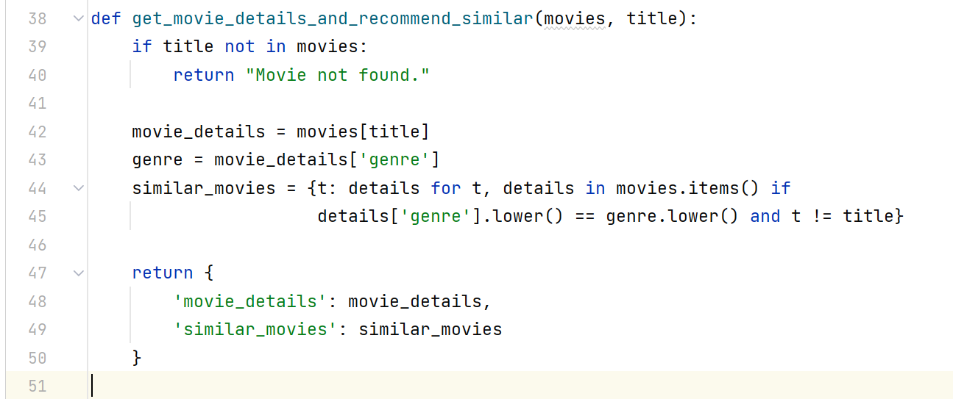
Search & Recommend
We input the title of the movie and then we output.
Details about the movie (found using Linear Search).
Similar movies are Sorted (Bubble Sort) & Recommended based on genre.

Slide 7
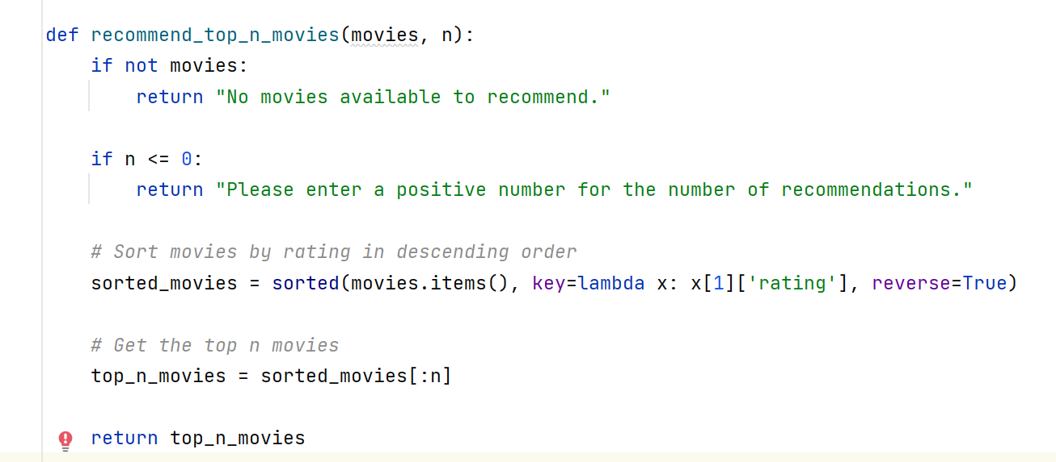
Recommend Top N
We enter the number of top movies we want to recommend & then our program sorts the movies using bubble sort. And then returns the top n movies based on the ratings.

Slide 8
Outputs
Adding Movies
Movie '3 Idiots' added successfully.
Movie 'Dangal' added successfully.
Movie 'Sholay' added successfully.
Movie 'Dilwale Dulhania Le Jayenge' added successfully.
Movie 'Gully Boy' added successfully.
Deleting Movies
delete_movie(movies, "Sholay")
Movie 'Sholay' deleted successfully.

Slide 9
Outputs
Searching for a Movie Based On Genre
result = search_movie_by_genre(movies, "Drama")
print(result)
{
'Dangal': {'genre': 'Drama', 'rating': 8.4},
'Gully Boy': {'genre': 'Drama', 'rating': 8.0}}
Recommending Top N Movies based on ratings
movies = {
"3 Idiots": {"genre": "Comedy", "rating": 8.4},
"Dangal": {"genre": "Drama", "rating": 8.4},
"Sholay": {"genre": "Action", "rating": 8.2},
"Dilwale Dulhania Le Jayenge": {"genre": "Romance", "rating": 8.1},
"Gully Boy": {"genre": "Drama", "rating": 8.0}}

Slide 10
Outputs
Searching for a Title & Recommending Similar Movies
result = get_movie_details_and_recommend_similar(movies, "The Godfather")
print(result)
{
'movie_details': {'genre': 'Crime', 'rating': 9.2},
'similar_movies': {
'Pulp Fiction': {'genre': 'Crime', 'rating': 8.9},
'The Godfather Part II': {'genre': 'Crime', 'rating': 9.0}
}
}

